Slide 1

Title: How do you decide what you believe about COVID?
I can…
Define sources and propaganda
Starter:
Which is the odd one out?
I can... understand why it is important to know where sources come from
I can… apply a formula to decide if a source is reliable
Clue:You would only see two of these people on the street, but all exist on the net and in magazines

Slide 2
Title: How do you decide what you believe about COVID?
I can…
Define sources and propaganda
Not everything online and in the media is what it seems… we need to be cautious when deciding what we believe!
I can... understand why it is important to know where your source is from
I can... understand why it is important to know where sources come from
CGI
She does not exist
CGI
She does not exist
I can… apply a formula to decide if a source is reliable
Clue:You would only see two of these people on the street, but all exist on the net and in magazines

Slide 3
Important keywords
Sources: Anything which gives information including TV, social media, magazines, books and websites
Critical literacy: Judging the reliability of sources
Propaganda: Misleading information which gives a bias view
If something is trustworthy
One sided often to encourage a certain view

Slide 4


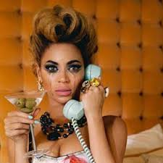
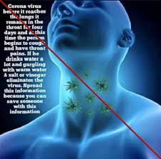
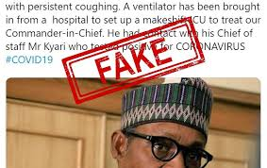
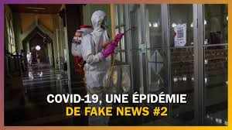
Why does knowing where sources come from matter? The better informed we are, the better choices we make and the safer we are.
Question: How could believing fake news impact someone’s life and choices?

Slide 5
Why does it matter to know where your sources come from? The better informed we are, the better choices we make and the safer we are
Isolated
Anxious
Anxious
Hurting other people
Hurting other people
Not trusting people around them
Not trusting people around them
Damaging their health
Damaging their health
Spreading false news

Slide 6
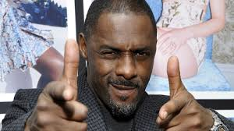
How do you decide what you believe?
Today, we will learn a formula to help us stay safe and avoid false news and practise critical literacy!

Slide 7

The magic formula: To decide which sources to believe try using this!
I can…
Define source᷾s and propaganda
I can... understand why it is important to know where sources come from
W
ho made it?
I can… apply a formula to decide if a source is reliable
W
here was it posted?
W
hen did they make it?
Note: You don’t have to be online to use WWW, it works for all types of sources

Slide 8
The magic formula: To decide which sources to believe try using this!
I can…
Define source᷾s and propaganda
If you can answer these questions, you can decide if the news is fake!
Let’s test it out!
I can... understand why it is important to know where source come from
W
ho made it?
I can… apply a formula to decide if a source is reliable
W
here was it posted?
W
hen did they make it?
Note: You don’t have to be online to use WWW, it works for all types of sources

Slide 9
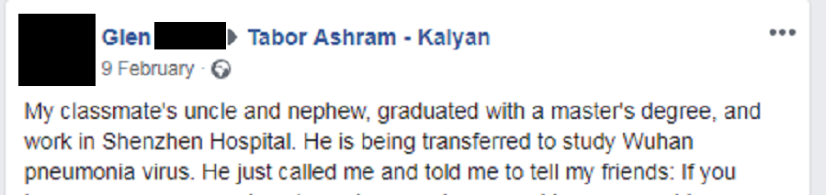

Title: How do you decide what you believe?
WOULD YOU BELIEVE OR SHARE THIS INFORMATION?
10 SECOND DISCUSSION.
Notes:
This piece of fake news got massive shares., it tricked a lot of people who should go to the NHS website, science based journals for information

Slide 10
Title: How do you decide what you believe?
W
ho made it?
W
here was it posted
W
hen did they make it?
You don’t know this person’s classmates uncle- and no name was given. There is no way of knowing if he is a real medical specialist or if this advice is correct. If you can’t say exactly who made it, it isn’t reliable. Where could you go for real advice on medical issues?
Notes:
This piece of fake news got massive shares., it tricked a lot of people who should go to the NHS website, science based journals for information

Slide 11
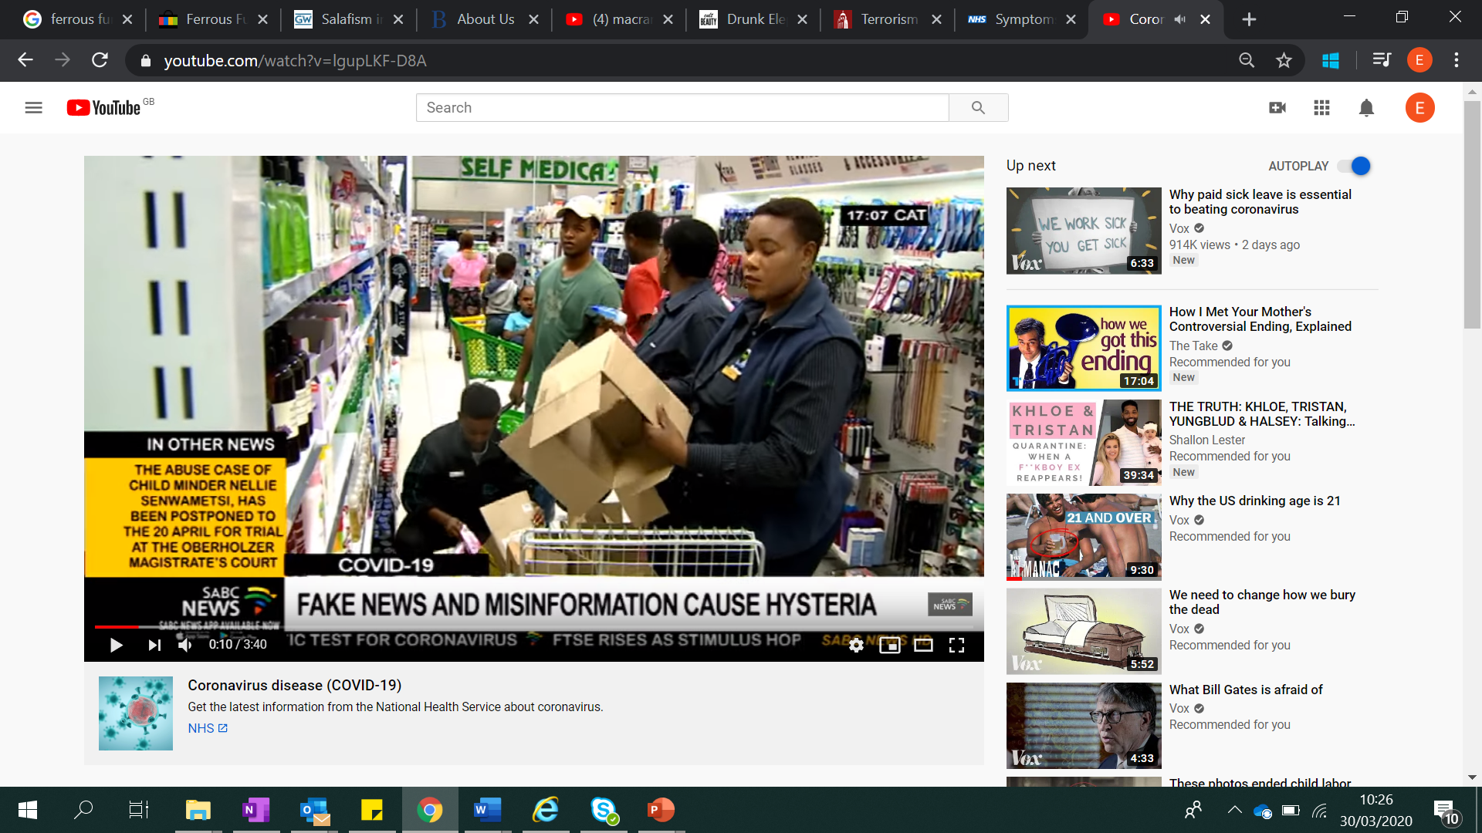
Title: How do you know what to believe?
You see a youtube video from someone who states that they are suffering from COVID and are getting cured by gargling ice water and drinking ginger tea. They say that they definitely have the illness and have had a test to prove it. They say they will sell you the tea that made them better
Note: You don’t have to be online to use WWW, it works for all types of sources

Slide 12
Title: How do you decide what you believe?
You see a youtube video of someone who states that they are suffering from COVID and are getting cured by gargling ice water and drinking ginger tea. They say that they definitely have the illness and have had a test to prove it.They are selling the ginger tea product
W
ho made it?
W
here was it posted
W
hen did they make it?
You don’t know this person. There is no way of knowing if they actually have COVID. They are sharing information to try and get you to buy something and there is no evidence apart from them saying so that it works. This is not trustworthy and someone trying to make money
Notes:
This piece of fake news got massive shares., it tricked a lot of people who should go to the NHS website, science based journals for information

Slide 13
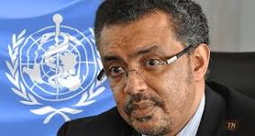
Title: How do you know what to believe?
You receive a text saying “I am a Dr. Tedros Adhanon from the World Health Organisation. These are my 10 ways to avoid COVID… The text then list 10 things to do”
Note: You don’t have to be online to use WWW, it works for all types of sources

Slide 14
Title: How do you decide what you believe?
W
ho made it?
W
here was it posted?
W
hen did they make it?
Dr. Tedros Adhanon is the Head of the World Health Organisation so has a good knowledge of COVID but it is not possible to know if it is really him over a text and reliable medical information should link to a hospital, university or government site- a text by itself is not a reliable source.
Notes:
This piece of fake news got massive shares., it tricked a lot of people who should go to the NHS website, science based journals for information

Slide 15
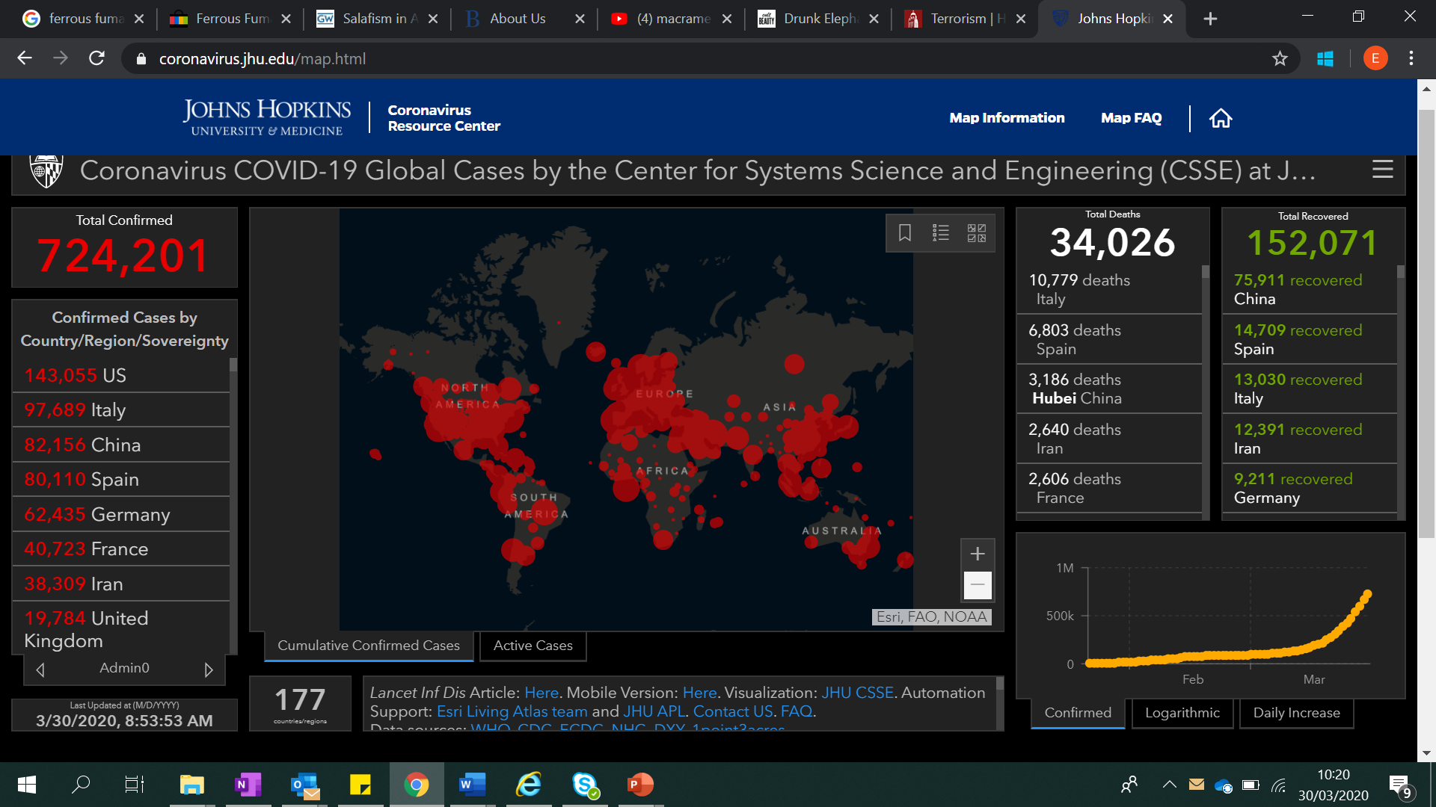
Title: Would you share this map of COVID cases from around the world??
This is a map of cases from the Uni
This is a map of cases around the world from John Hopkins’ University Medical School. It is updated everyday based on information from hospitals and governments around the world. It is found on the official university website.

Slide 16
Title: How do you decide what you believe?
W
ho made it? John Hopkins University Research Center
W
here was it posted? The official university website
W
hen was it made? The information is updated daily
WWW.- We know where it is from and it is posted on an official website from a research university. The information is also up to date. Remember as information is being changed daily, it is important to check if the information that you are reading is new or a few weeks old.

Slide 17

Title: Would you share this map of COVID cases from around the world??
Note: You don’t have to be online to use WWW, it works for all types of sources

Slide 18
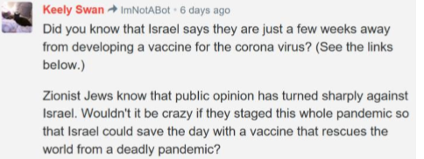
Try this test example- Is this reliable? Would you share this news?
W
ho made it?
W
here was it posted?
W
hen did they make it?
Note: You don’t have to be online to use WWW, it works for all types of sources

Slide 19
Try this test example- Is this reliable? Would you share this news?
FAKE NEWS
W
ho made it?
W
here was it posted?
W
hen did they make it?
Note: You don’t have to be online to use WWW, it works for all types of sources

Slide 20

University Websites
Doctor’s advice
30 second Task:
Sort the sources into the correct boxes!
Comments on social media
NHS site
youtubers
Tabloid papers
Opinions of friends
Support: Tabloid means papers with gossip and exaggerated stories
Most reliable | Somewhat reliable | Least reliable
Stretch: Can you think of any others?
Note: You don’t have to be online to use WWW, it works for all types of sources

Slide 21
30 second Task:
Sort the sources into the correct boxes!
Support: Tabloid means papers with gossip and exaggerated stories
Most reliable | Somewhat reliable | Least reliable
University Websites
Comments on social media
NHS site
Tabloid papers
Stretch: Can you think of any others?
Doctor’s advice
youtubers
Opinions of friends
Note: You don’t have to be online to use WWW, it works for all types of sources

Slide 22
Make a fake news story… join together these words in any format and create
Fake News:
Intentionally misleading content created to misinform the reader to either discredit real stories either for political and/ financial gain
The Queen
Isis
Beyonce
Paid for
killed
joined
The Illuminati
The Eurovision Song contest
Boris Johnson
to spread COVID
Note: You don’t have to be online to use WWW, it works for all types of sources

Slide 23
Make a fake news story… join together these words in any format and create a
Fake News:
Intentionally misleading content created to misinform the reader to either discredit real stories either for political and/ financial gain
The Royal Family
Isis
Beyonce
Paid for
killed
joined
The Illuminati
The Eurovision Song contest
Boris Johnson
to spread COVID
Note: You don’t have to be online to use WWW, it works for all types of sources

Slide 24
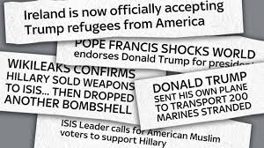
Whatever you made is as strange as the materials which you can find online
Fake News:
Intentionally misleading content created to misinform the reader to either discredit real stories either for political and/ financial gain is all over the internet.
DON’T GET FOOLED- USE WWW.
Note: You don’t have to be online to use WWW, it works for all types of sources

Slide 25
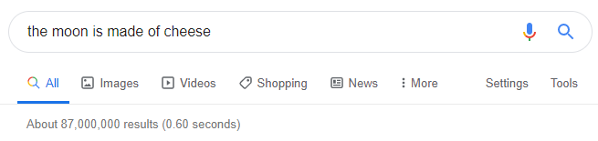
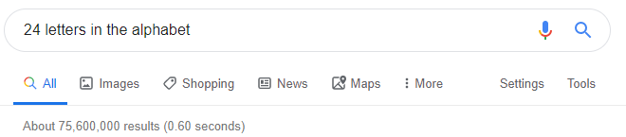
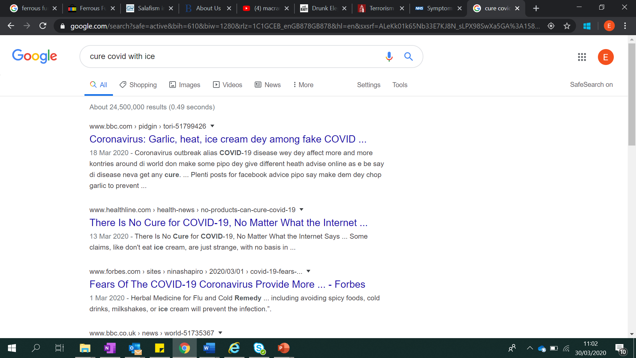
How do you decide what to believe?
Can google hits alone help us decide what is and isn’t true?
Note: You don’t have to be online to use WWW, it works for all types of sources

Slide 26
How do you decide what to believe?
Check your sources and create an informed opinion
I can…
Define source᷾s and propaganda
I can... understand why it is important to know where sources come from
W
ho made it?
I can… apply a formula to decide if a source is reliable
W
Here was it posted?
W
hen did they make it?
Note: You don’t have to be online to use WWW, it works for all types of sources

Slide 27
HELPFUL WEBSITE:
If you hear some information but want to check and see if it is real, here are a list of websites which update daily updates.
https://www.nhs.uk/ - For information on COVID 19 from the National Health Service
https://coronavirus.jhu.edu/map.html – For information on the spread worldwide of COVID19
https://www.gov.uk/coronavirus- For information on the law, isolation and figures for COVID 19 in the UK
https://www.who.int/emergencies/diseases/novel-coronavirus-2019 –For information on worldwide responses to COVID 19
https://www.bbc.co.uk/newsround -For child appropriate explanations of COVID 19
Note: You don’t have to be online to use WWW, it works for all types of sources

Slide 28
STAY SAFE, STAY INFORMATION AND STAY CRITICAL!
Made by Elizabeth Kitto on behalf of Barking and Dagenham Local Authority
Elizabeth.kitto@lbbd.gov.uk

